Slide 1

Introduction to Software Business Product management
Week 1 Day 3
Led by:
Emily Crose
Oakland University

Slide 2





Day 2 recap

Slide 3


Question or Clarifications?

Slide 4

Networking

Slide 5

What Does Your Home Network Look Like?
Notes:
Let’s have a quick discussion. What does your home network look like? What kind of devices are on your network?

Slide 6
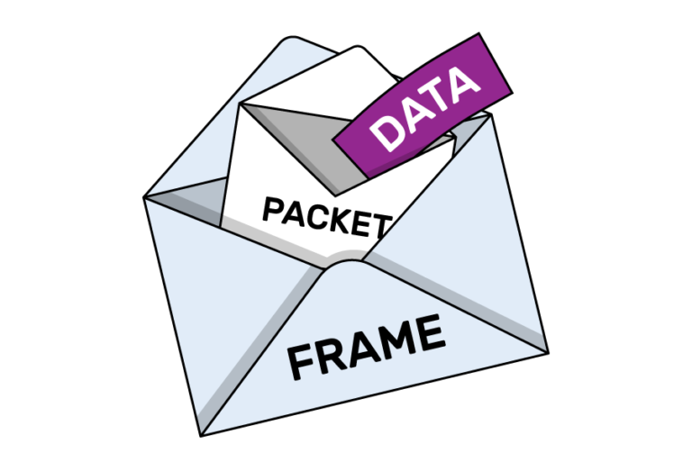
Packets

Slide 7
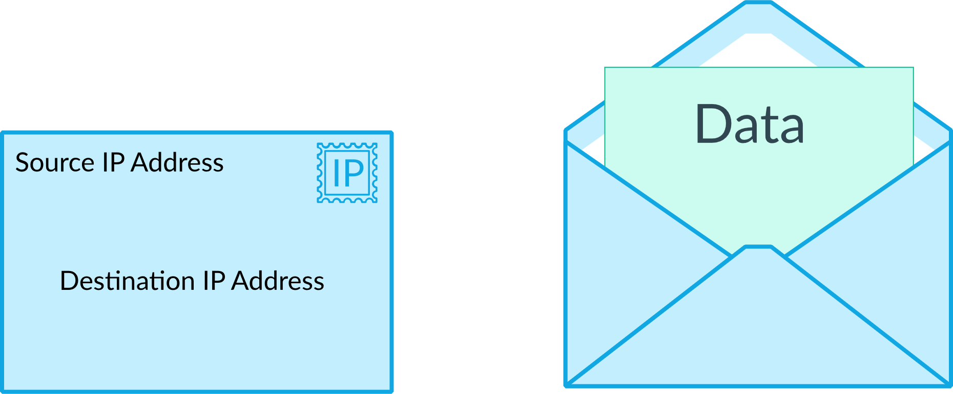

Slide 8
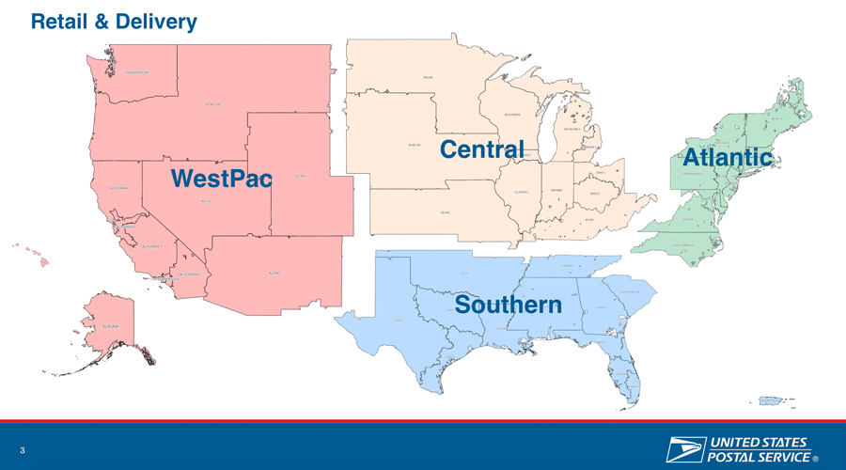

Slide 9
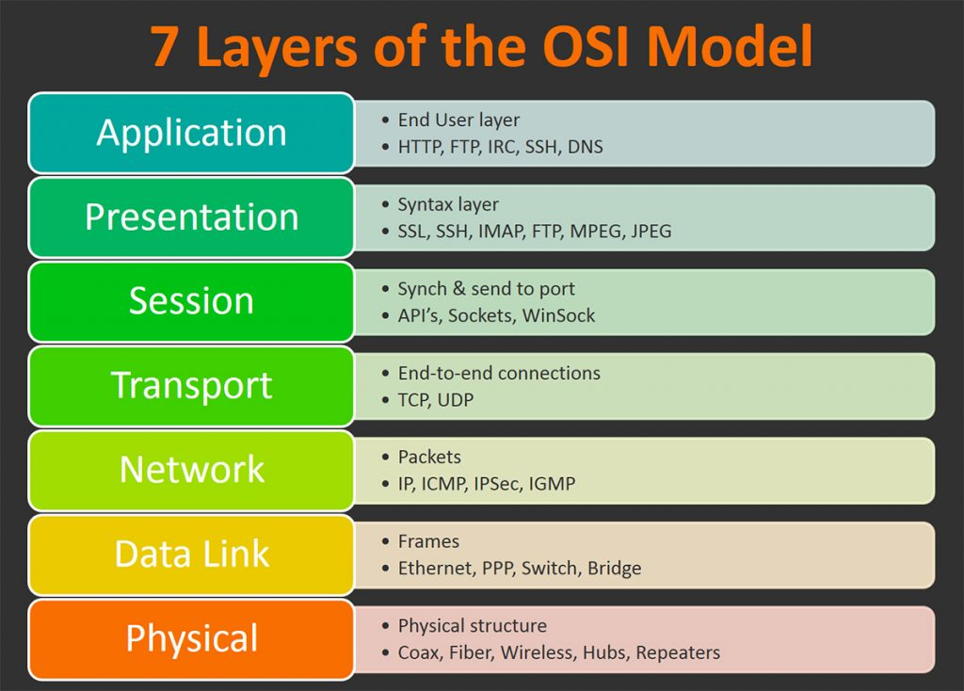

Slide 10
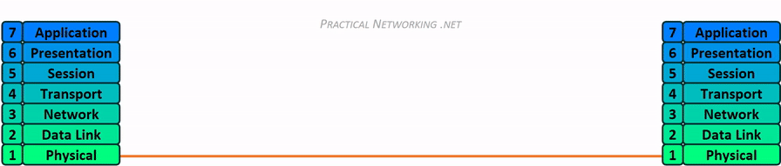
Network Transmission

Slide 11

Layer 1- Physical
Media Layer

Slide 12
Networking Hardware
Purpose
Provides a physical medium for transporting raw information
Wireless Antenna
Cat5 (Ethernet) Cables
Coaxial Cables
Fiber Optic Cables
Network Hubs
Network Repeaters

Slide 13

Layer 2 - Data Link
Media layer

Slide 14
Layer 2
Purpose
Provides error-free transfer of data frames from one node to another via the physical layer
Physical
Network Switch
Network Bridge
Logical
“Frames”

Slide 15
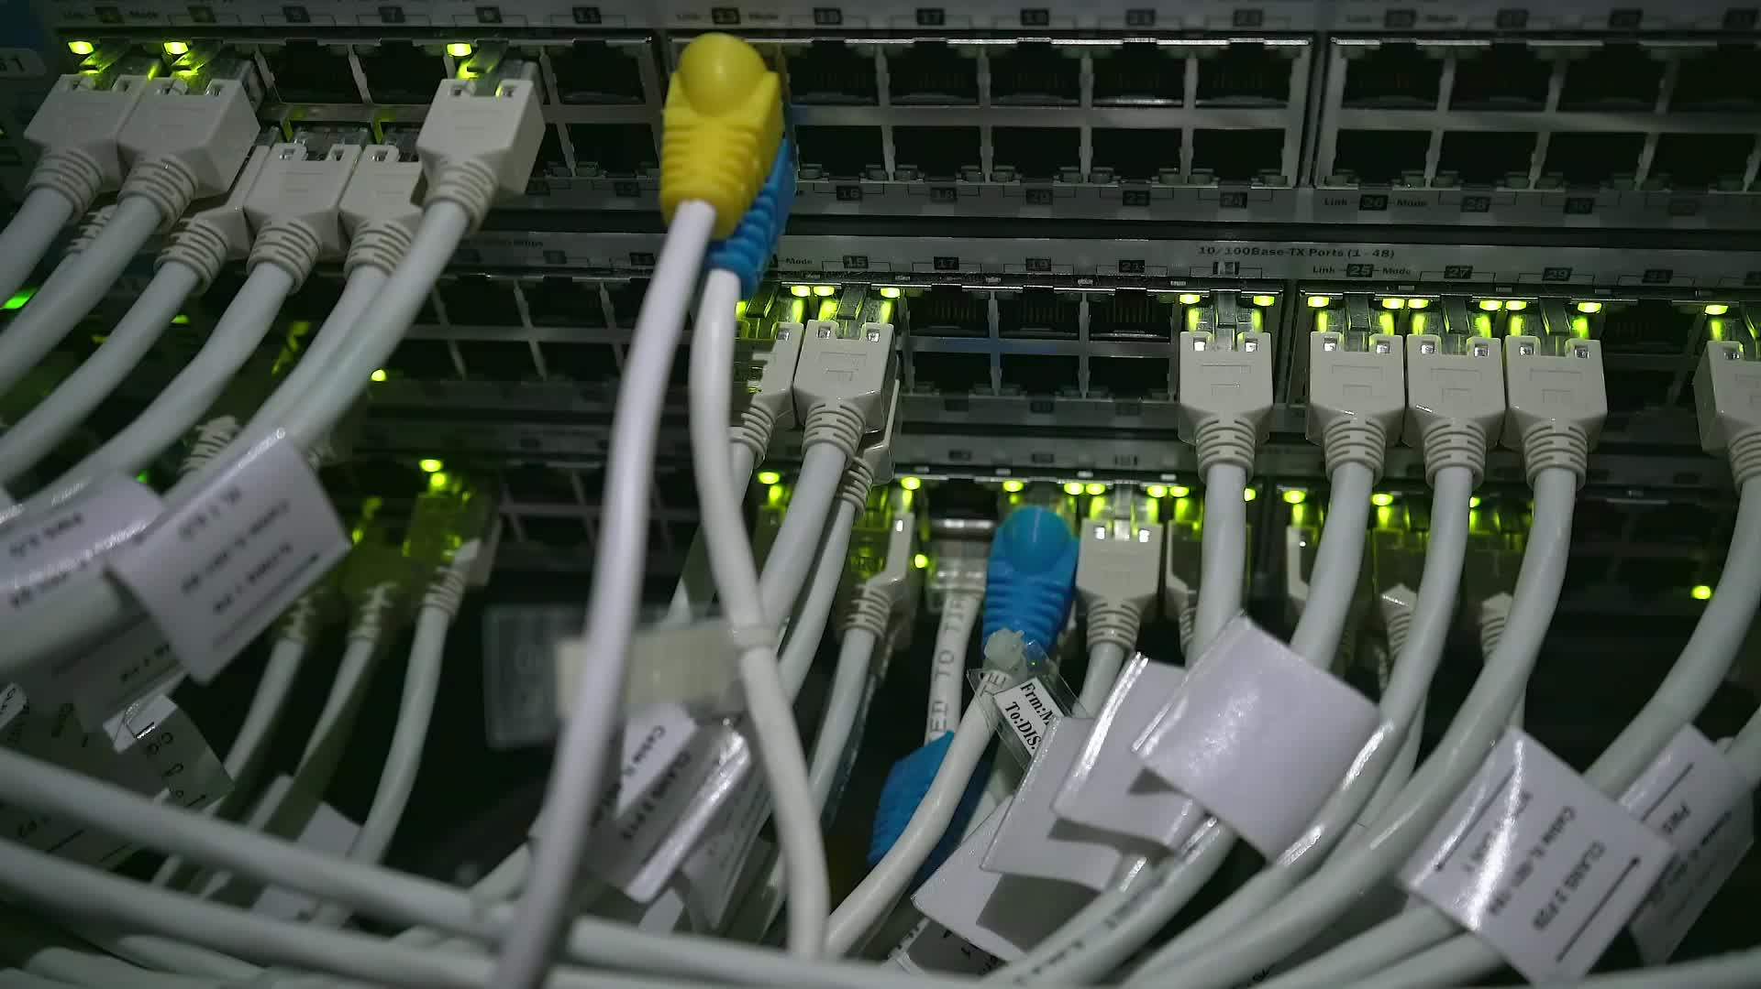
Layer 3 - Network
Media Layer

Slide 16
Layer 3
Purpose
Controls the operations of the subnet.
Decides which physical path data will take
Physical
Router
Logical (Protocols)
IP
ICMP
IPSec
IGMP

Slide 17
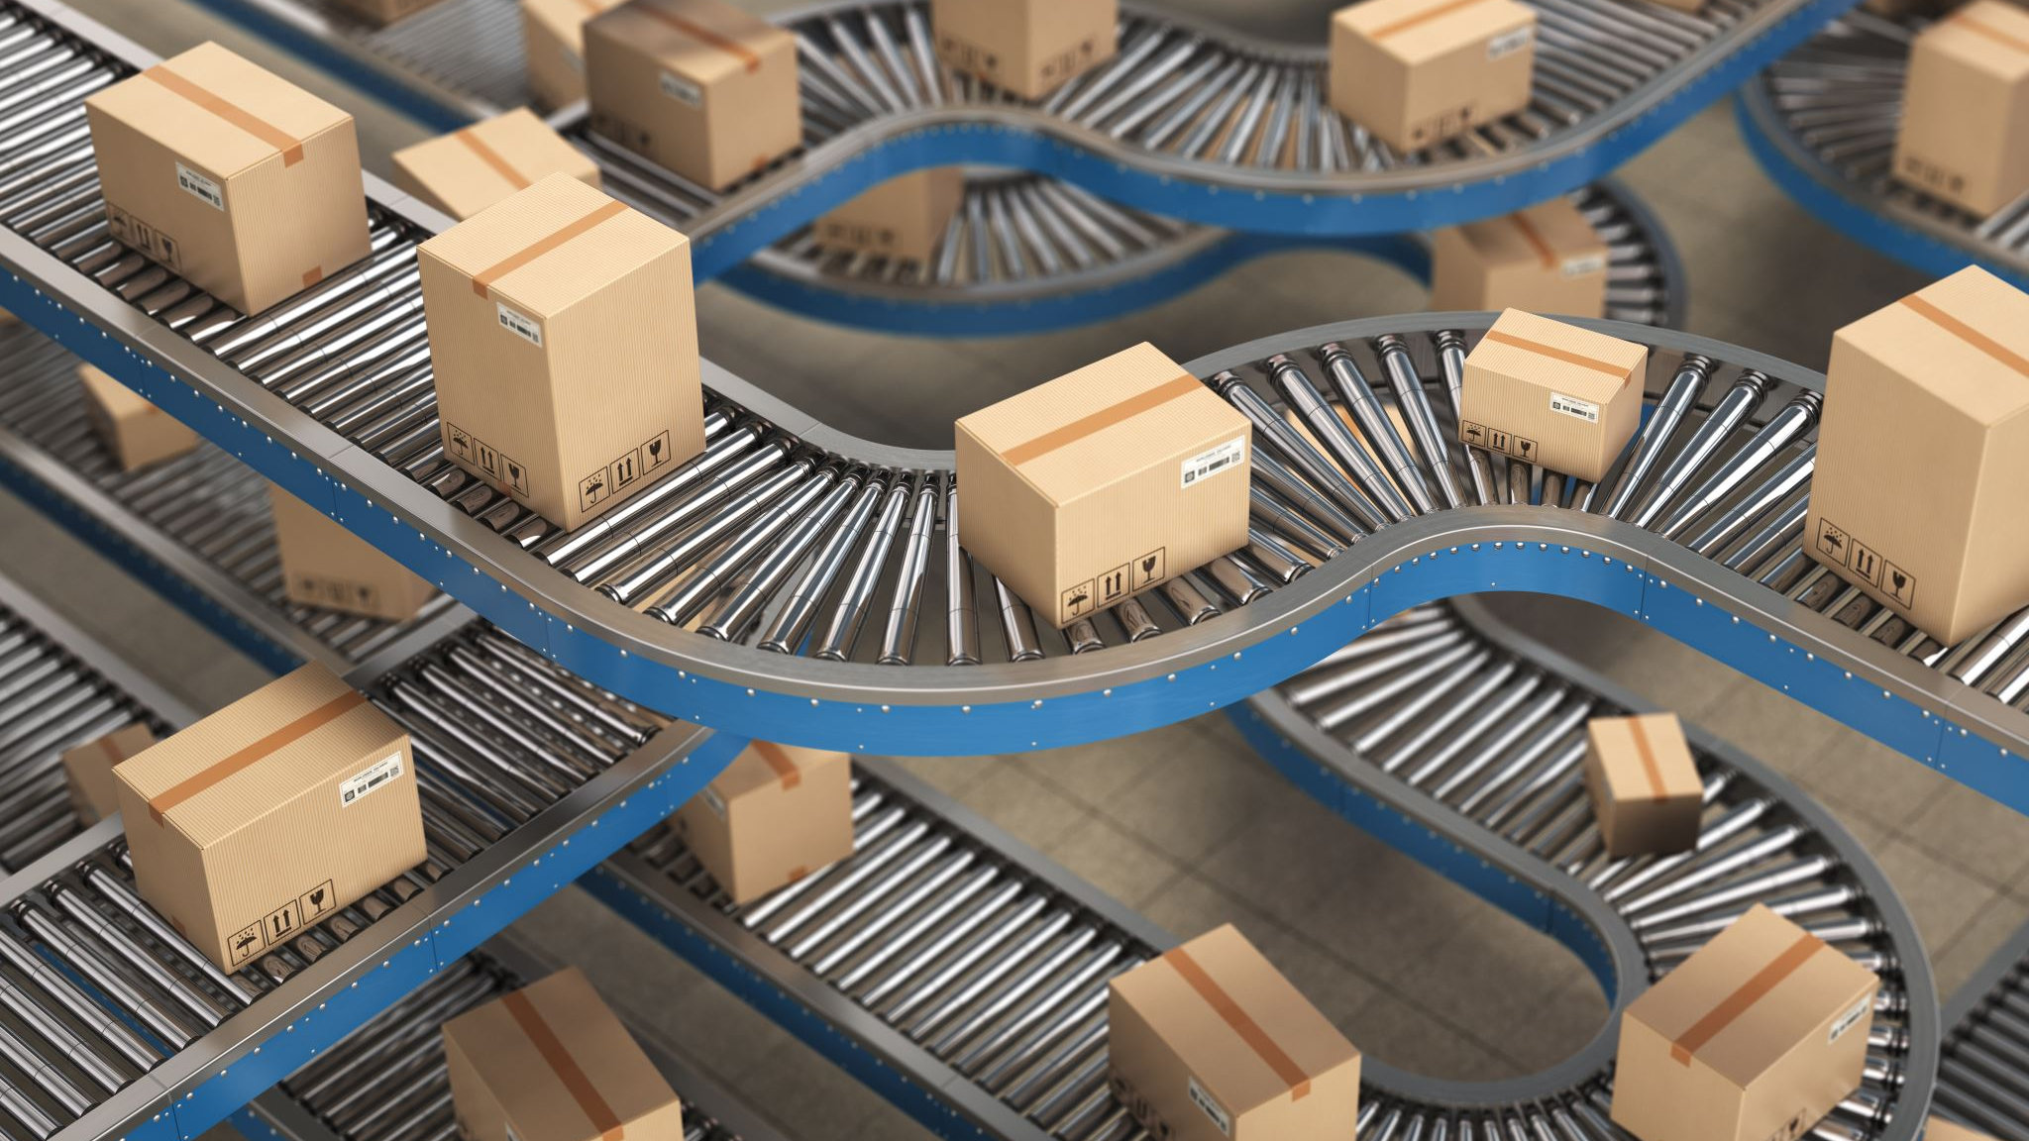
Layer 4 - Transport
Host Layer

Slide 18
Layer 4
Purpose
Ensures that messages are delivered in sequence without losses, errors or duplications
Logical
TCP
UDP

Slide 19
TCP VS. UDP

Slide 20
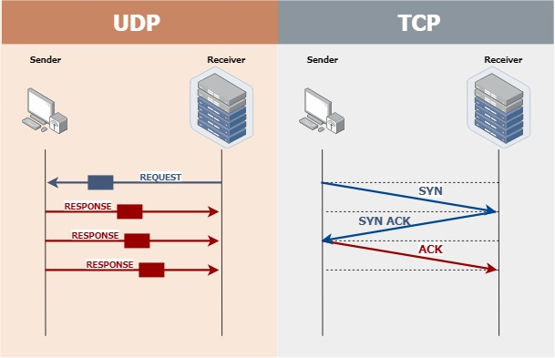

Slide 21
TCP Handling

Slide 22
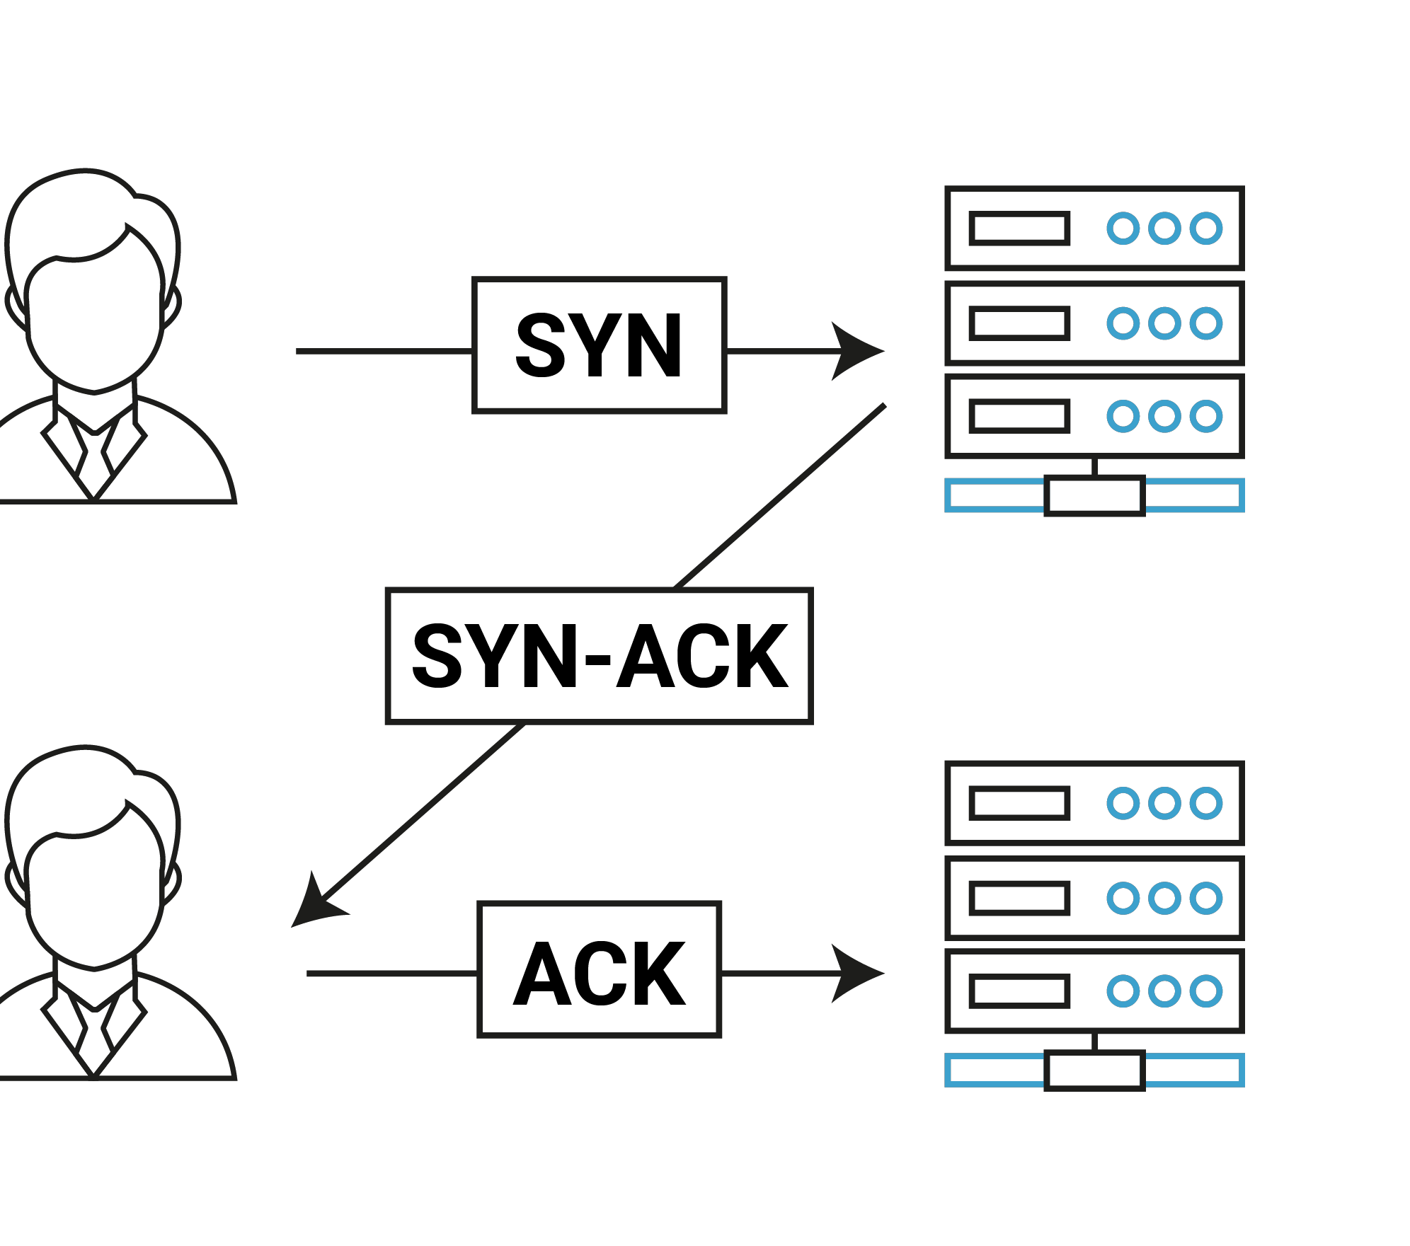
TCP 3-Way Handshake

Slide 23
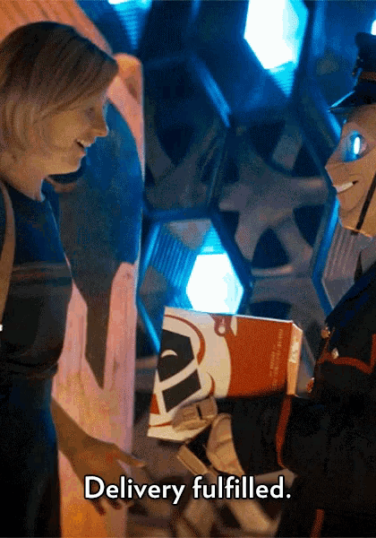
Explain TCP In A Gif

Slide 24
UDP Handling

Slide 25

Explain UDP In A Gif

Slide 26
Discussion: TCP Apps & UDP Apps
Moodle
TCP or UDP?
VoIP
TCP or UDP?
YouTube
TCP or UDP?
SWIFT Money Transfers
TCP or UDP?

Slide 27
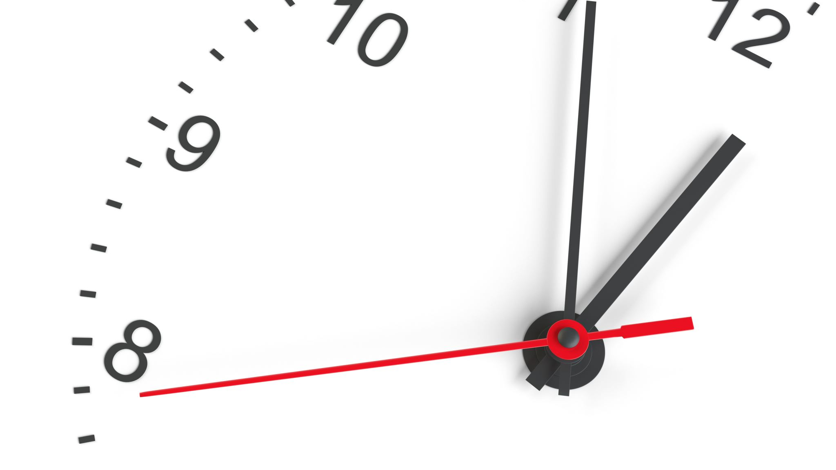
10 minute break

Slide 28
Layer 5 – Session
Host layer

Slide 29
Layer 5
Purpose
Allows the establishment of sessions between processes
Protocols
RPC
SQL
NFS
Netbios

Slide 30

Layer 6 – Presentatioin
Host layer

Slide 31
Layer 6
Purpose
Formats data bound for the application layer (layer 7)
Protocols
JPG
ASCII
ANSI
GIF
WEBP

Slide 32
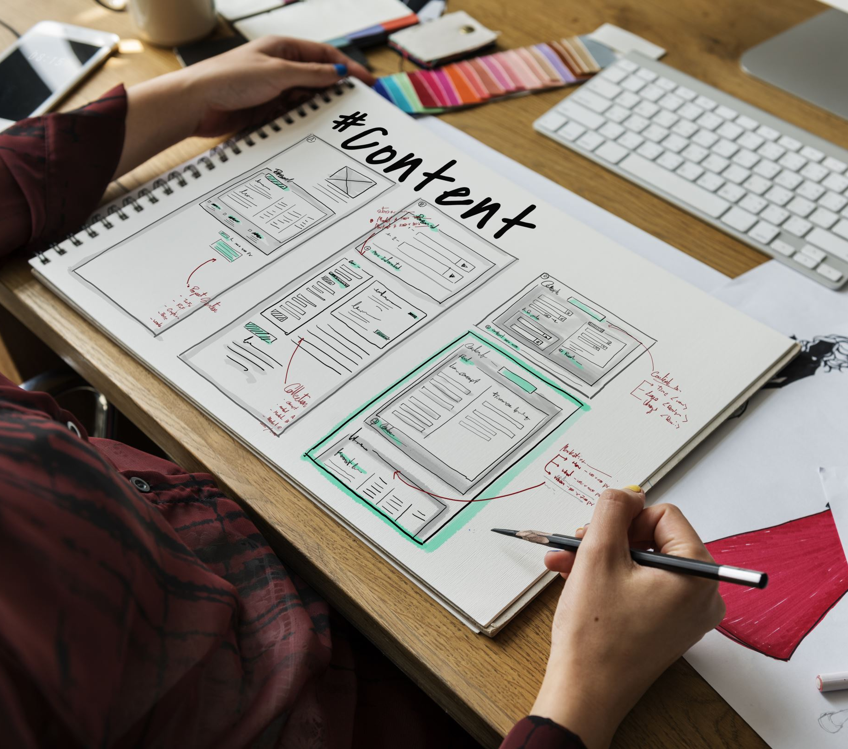
Layer 7 – Application
Host layer

Slide 33
Layer 7
Purpose
Interface layers for users to access network resources
Protocols
SMTP
HTTP
Wiki
Microsoft Word

Slide 34

Shall We Play A Game?
https://static-labs.tryhackme.cloud/sites/osi-model-game/
Notes:
Let’s play a little network protocol game and see if we can remember the 7 layers of the OSI model!

Slide 35

Name Resolution

Slide 36
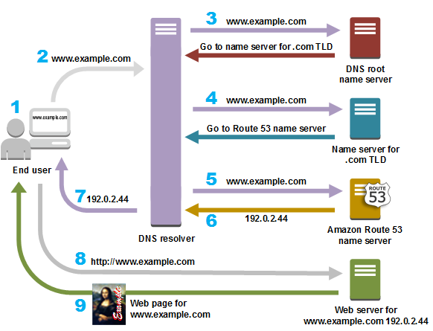
DNS

Slide 37

DNS: TCP or UDP?

Slide 38

Problem: How Do We Move Information?

Slide 39
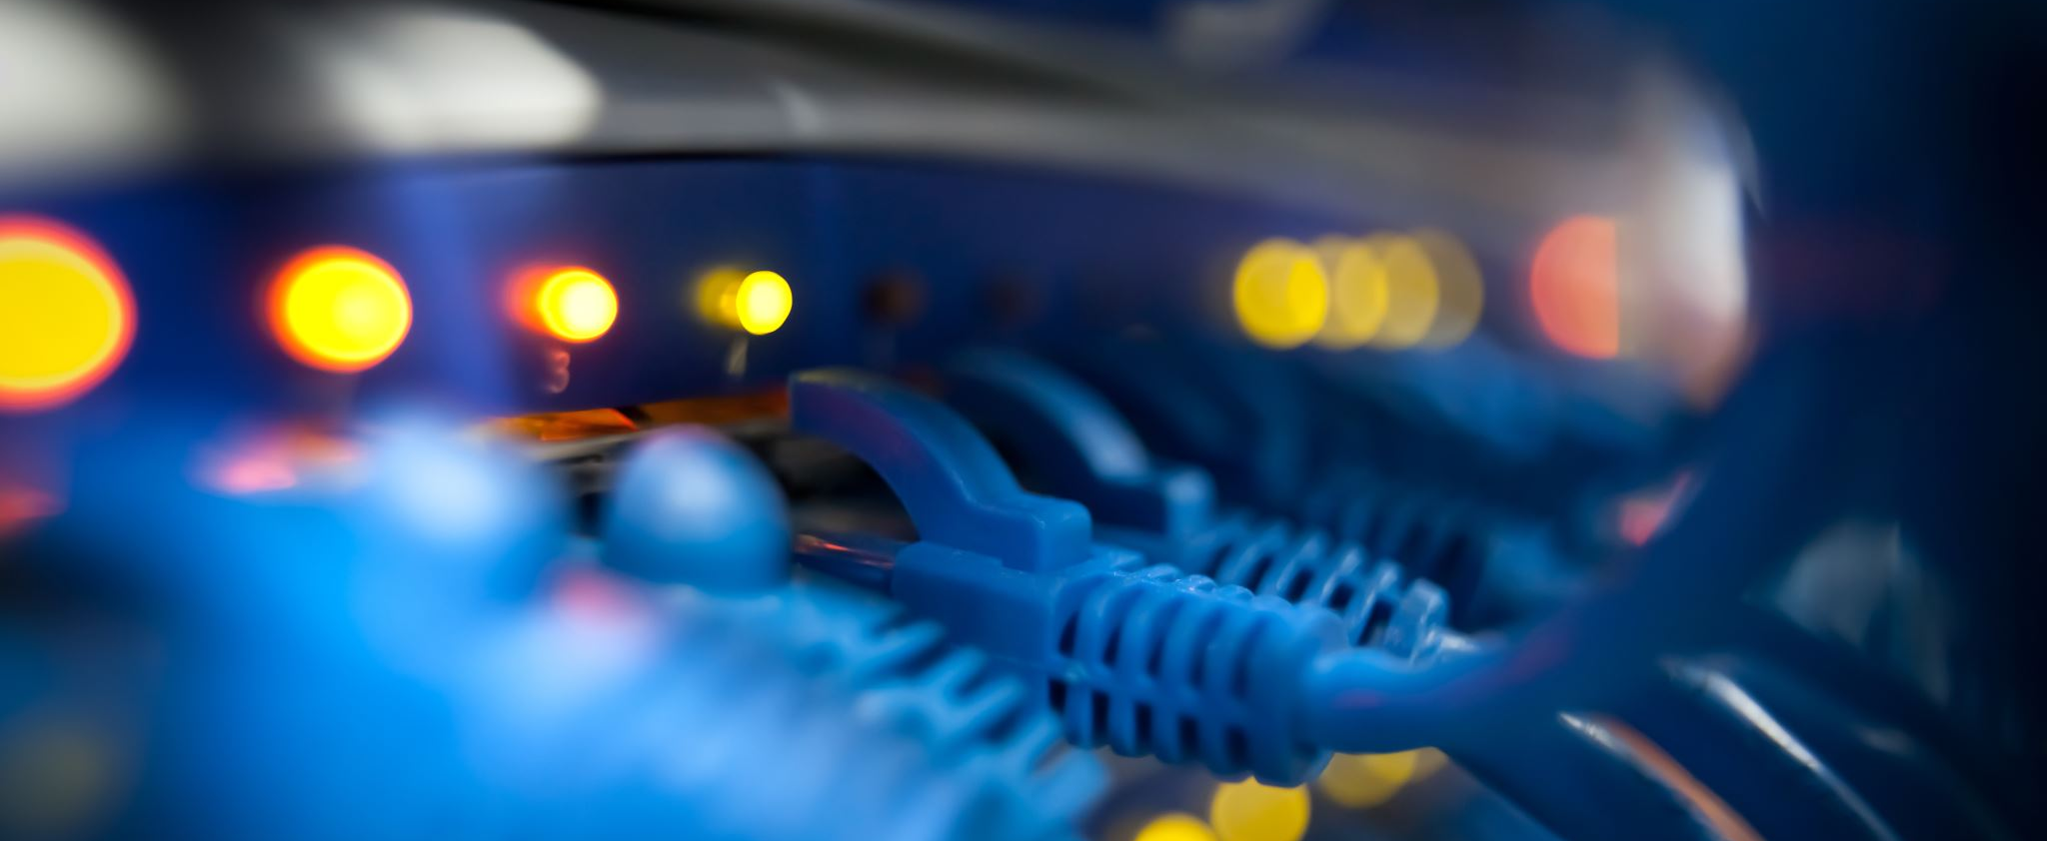
LANs and WANs

Slide 40
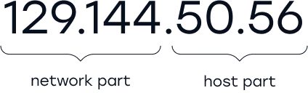
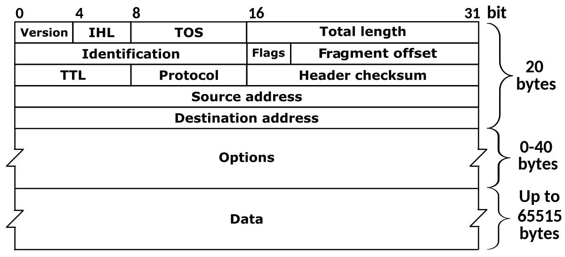
Network Operation

Slide 41
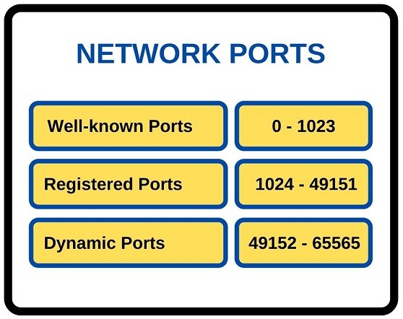
Network Ports

Slide 42
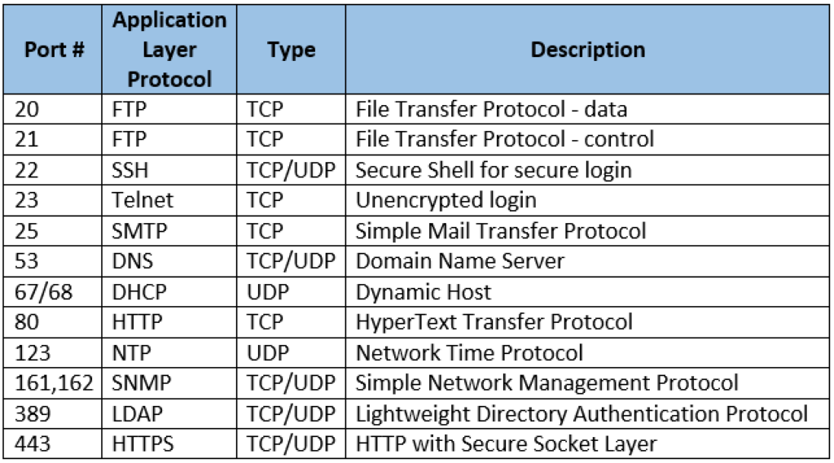
Common Ports

Slide 43
Local Area Network (LAN)
Allows connection to other nearby network-connected systems
You probably use some of these devices!
Amazon firestick
Google Chromecast
AppleTV
More protective of local information?

Slide 44
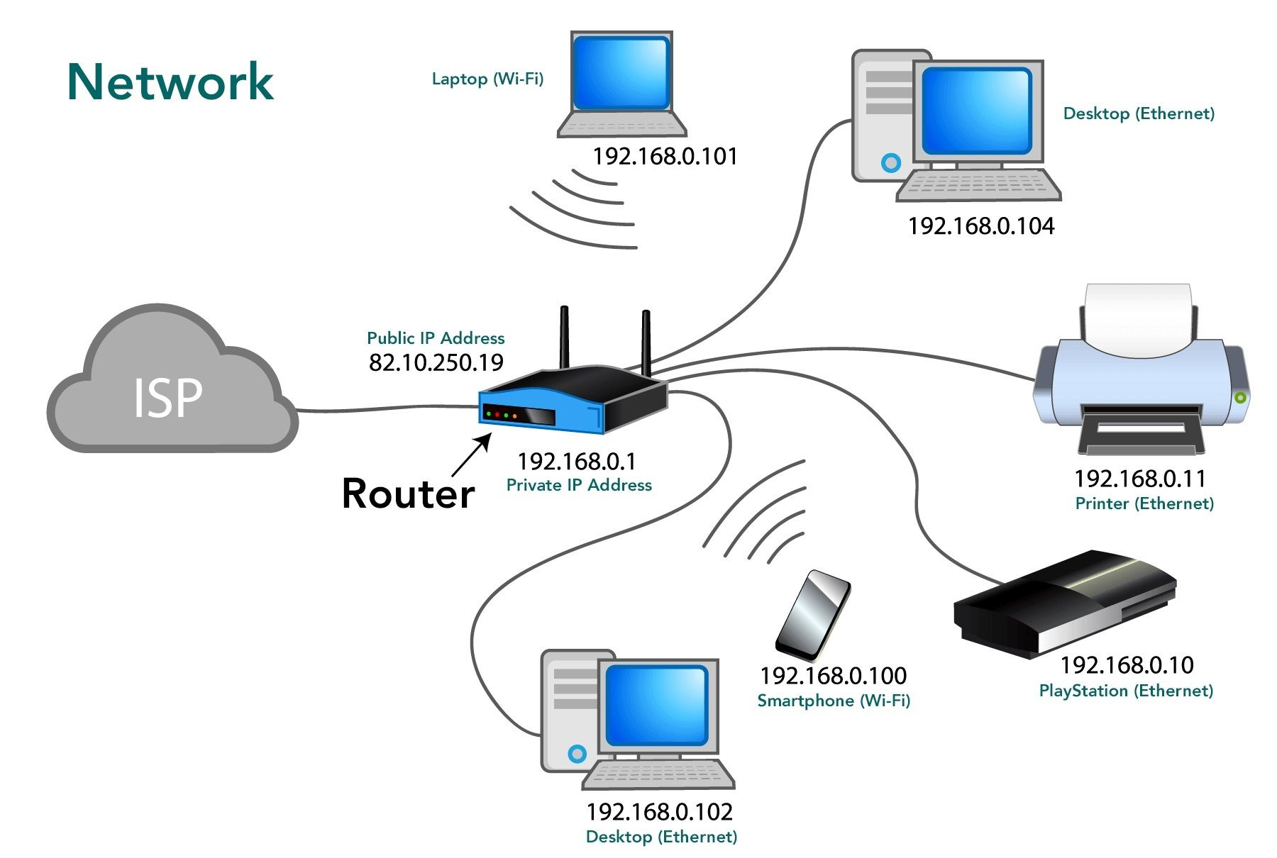
Basic Network Topology

Slide 45
Wide Area Network (WAN)
Allows connection to remote hosts
Websites
Remote backups/repositories
VPNs enable access to remote LANs

Slide 46
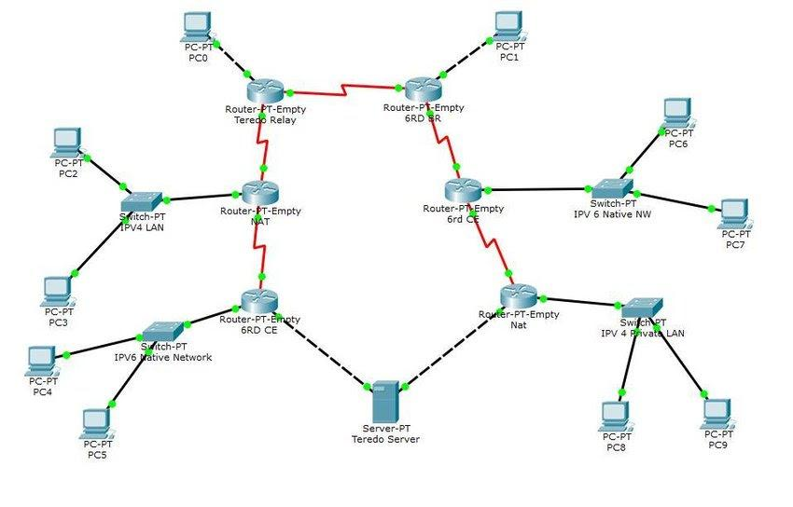
Complex Network Topology

Slide 47
10 minute break

Slide 48

How Do Apps Access Information?

Slide 49
Local & Remote Information
Local filesystem
Remote filesystem
Repositories
Databases
Local hard drive
Hard drive on another computer
Structured data
Typically holds frequently changing information
SQL, MSAccess, etc.

Slide 50
Day 3 Recap

Slide 51
Question or Clarifications?

Slide 52
Instructor Contact Info
ecrose@oakland.edu

